Slide 1


Slide 2
An Introduction to Microsoft Graph for Intune Management
Andrew Taylor

Slide 3
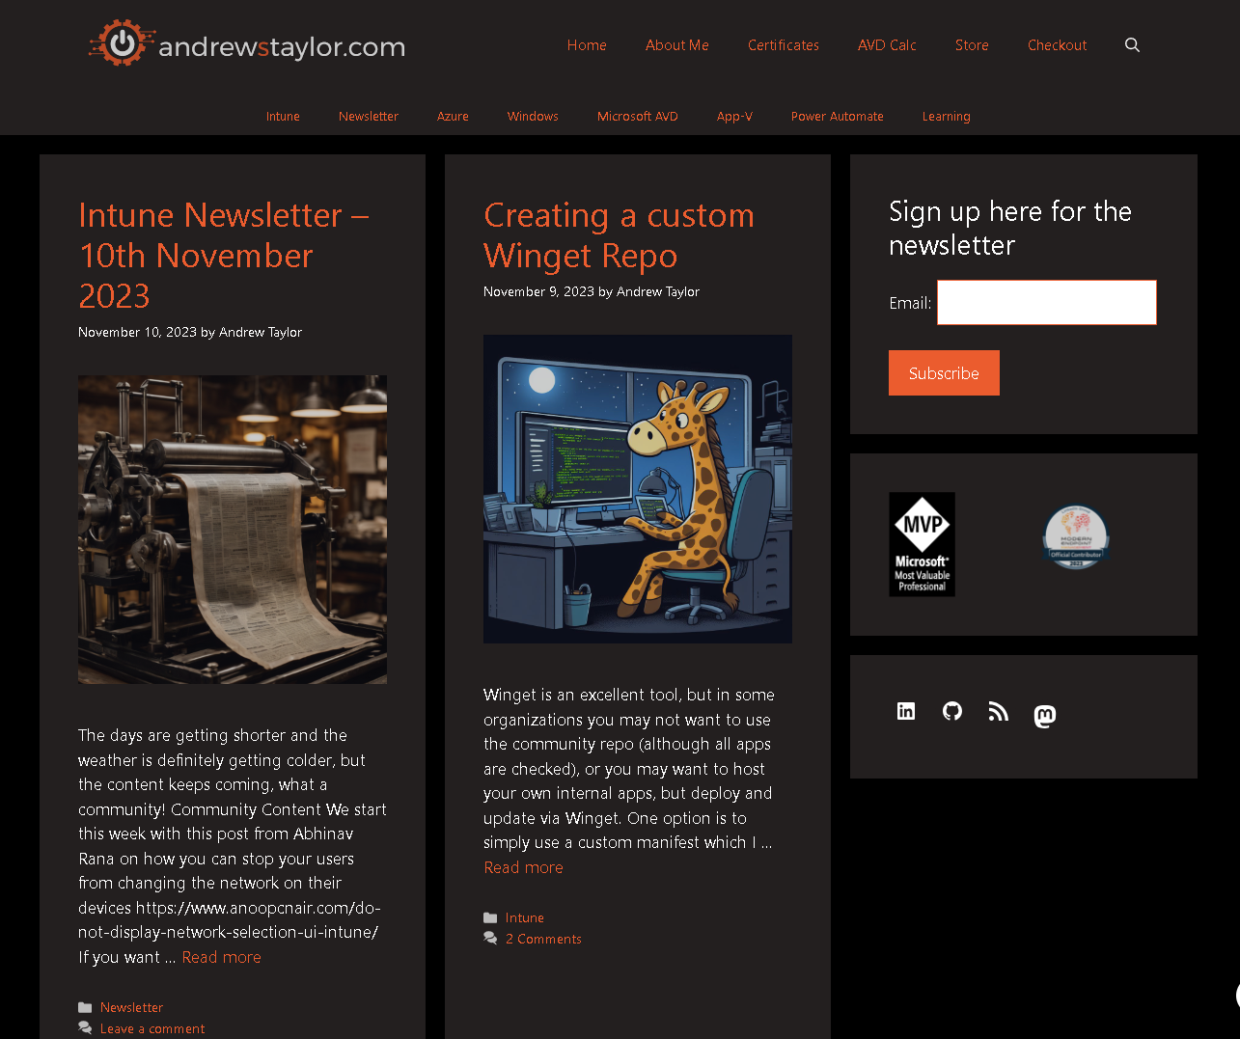

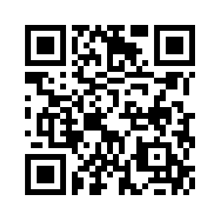
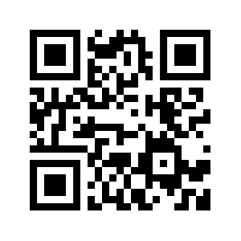
About me

Slide 4
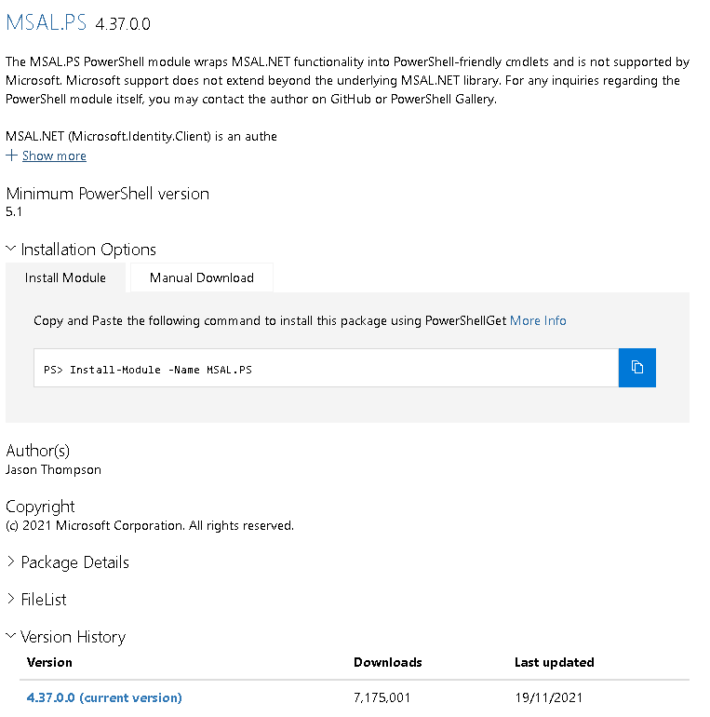
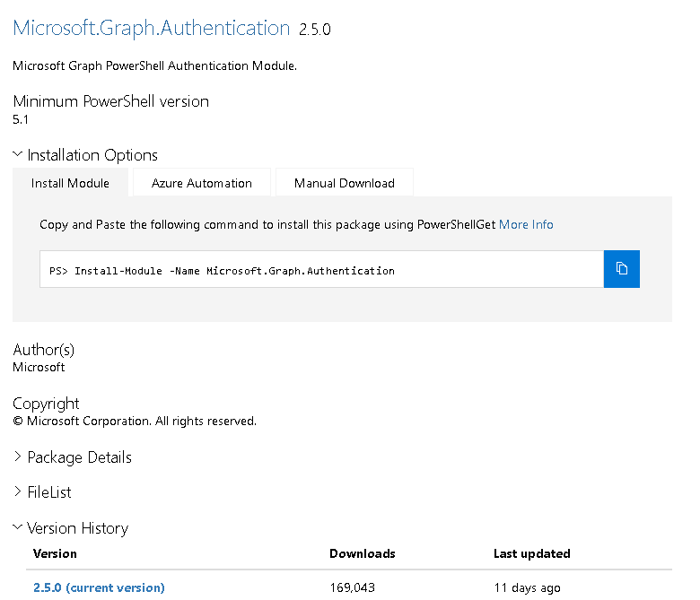
The battle of the auth module
4

Slide 5
JSON or Commandlet?
JSON
CommandLet
Only a single module to install
Less work if the SDK changes
Better understanding of what’s happening
Shorter Code
Easier to write
Can use Graph X-Ray Extension
More changes if SDK changes
Is it cheating?

Slide 6
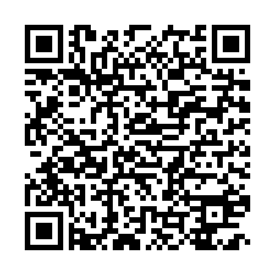
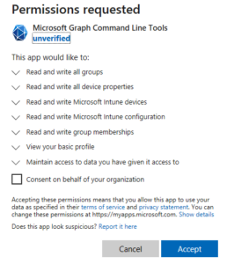
Authenticating - App Reg with Secret
Connect-MgGraph
Remember to include the required Scopes
Interactive – Requires someone present at the device
User connecting needs permissions

Slide 7
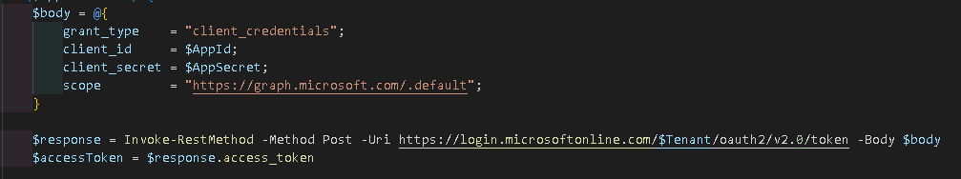
Authenticating – App Reg with secret
If using v2, remember the encrypt the token:
$accesstoken = ConvertTo-SecureString -String $accessToken -AsPlainText –Force
If using v1, set the profile:
Select-MgProfile -Name Beta
Then connect:
Connect-MgGraph -AccessToken $accesstokenfinal
You control permissions
No user needed so can be run in automation
User does not require any permissions to Graph
Secret either stored in plain text, or passed via parameter

Slide 8
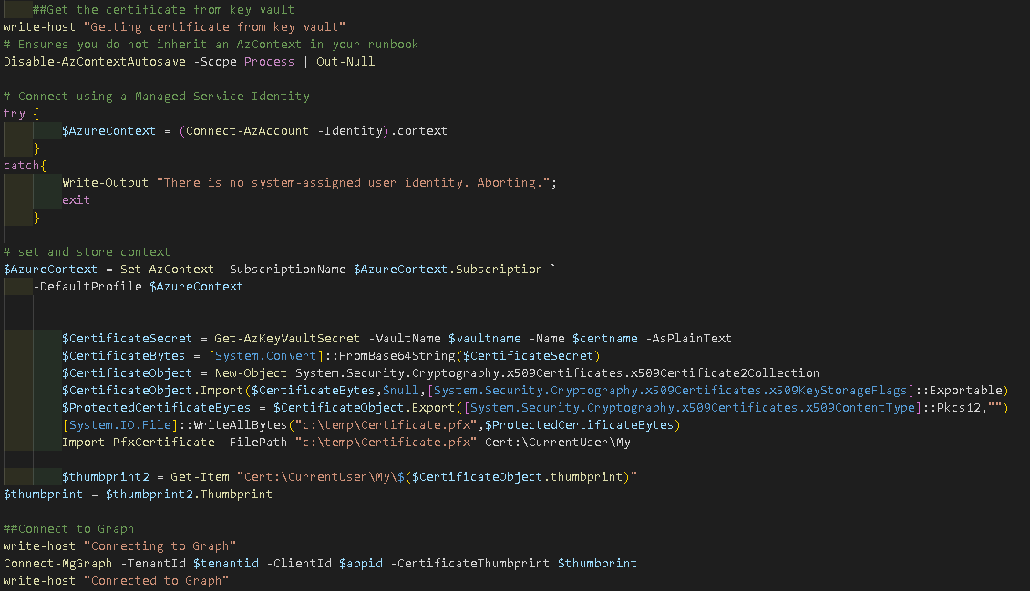
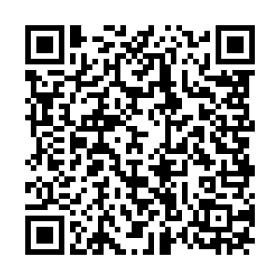
Authenticating - Service Principal
If single tenant and running via Azure automation, the most secure option
No password in plain text
Uses Azure Service Principal to grab certificate from key vault and connects with that to Graph

Slide 9
GET/POST/PUT/DELETE - What?
GET – This simply retrieves values from Graph to manipulate, export etc.
POST – This sends new values to Graph which do not currently exist (a new user, new policy)
PATCH – This updates an existing record
PUT – Similar to patch, but needs a full URL including the ID being created
DELETE – Deletes whatever you are pointing it at

Slide 10
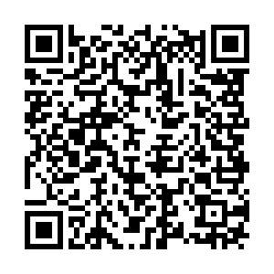
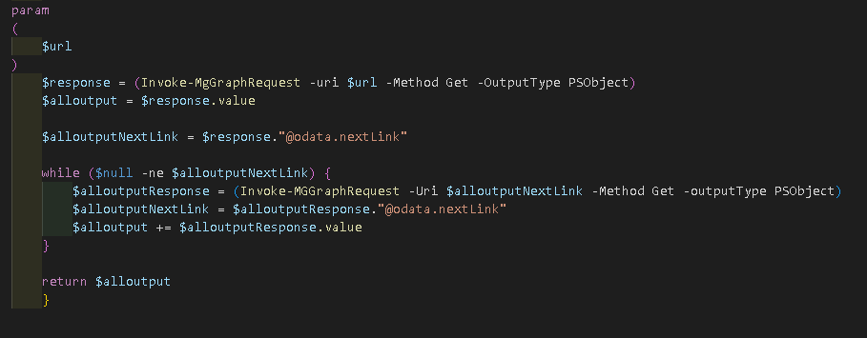
Pagination!
By default, Graph returns the first 50 objects with a link to view the next 50.
Doesn’t work so well with automation though!
Use my function getallpagination

Slide 11
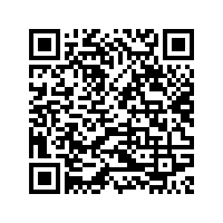
Settings Catalog
Great, but complex!
First, set the URL based on the platform
Then select the Category from the list for that platform
Select the policy from the list for that category
Find the options for the policy
Select the option
Populate the JSON
Send the request

Slide 12
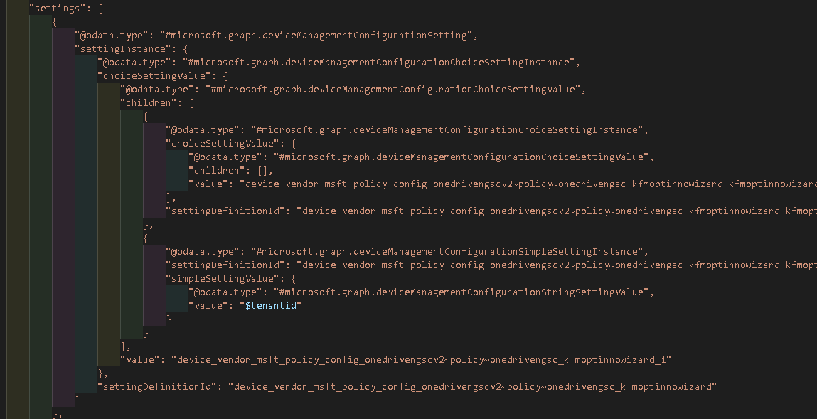
Settings Catalog

Slide 13
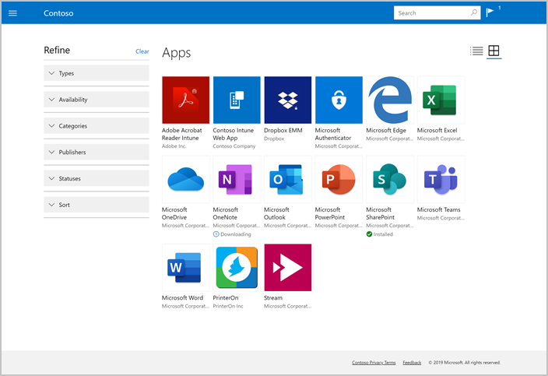
Win32 Apps
Create Detection Script
Create Install Script
Create Uninstall Script
Package into intunewin
Create Application stub in Intune with install/uninstall/detection
Upload intunewin to blob storage
Once uploaded, application is Committed to Graph and Azure

Slide 14

Retrieving Reports
Some reports do not support GET requests
Send a POST request, but response is not in JSON format
Send a request, output the response to a file
Ingest the file to read the content
Also needs pagination so need to create a new file for each 50 results and then combine

Slide 15
Retrieving Reports
$url = "https://graph.microsoft.com/beta/deviceManagement/reports/getAppsInstallSummaryReport" $json = @"
{
"filter": "",
"orderBy": [],
"select": [],
}
"@ $tempfilepath = $env:TEMP + "\appinstallstatus.txt"
Invoke-MgGraphRequest -Method POST -Uri $url -Body $json -ContentType "application/json" -OutputFilePath $tempfilepath
$parsedData = get-content $tempfilepath | ConvertFrom-Json
$fullvalues = $parsedData.Values
$allrows = $parsedData.TotalRowCount

Slide 16
Retrieving Reports
$n = 0
while ($n -lt $allrows) {
$n += 50
$tempfilepath2 = $env:TEMP + "\appinstallstatus-$n.txt"
$url = "https://graph.microsoft.com/beta/deviceManagement/reports/getAppsInstallSummaryReport"
$json = @"
{
"filter": "",
"orderBy": [],
"select": [],
"skip": $n,
"top": 50
}
"@
Invoke-MgGraphRequest -Method POST -Uri $url -Body $json -ContentType "application/json" -OutputFilePath $tempfilepath2
$tempdata = get-content $tempfilepath2 | ConvertFrom-Json
$fullvalues += $tempdata.Values
}

Slide 17
Scripts, Images and Files - Base64
Non intunewin files are stored in base64 format within Intune JSON
This applies to images, scripts, remediations etc.
$scriptcontent = @'
Get-AppxPackage -allusers -Name Microsoft.BingNews| Remove-AppxPackage -AllUsers
$Search = "HKLM:\SOFTWARE\Policies\Microsoft\Windows\Windows Search"
If (!(Test-Path $Search)) {
New-Item $Search
}
If (Test-Path $Search) {
Set-ItemProperty $Search AllowCortana -Value 0
}
'@
$base64encoded = [System.Convert]::ToBase64String([System.Text.Encoding]::Unicode.GetBytes($scriptcontent))

Slide 18
Examples
$scriptcontent = @'
Get-AppxPackage -allusers -Name Microsoft.BingNews| Remove-AppxPackage -AllUsers
'@
$base64encoded = [System.Convert]::ToBase64String([System.Text.Encoding]::Unicode.GetBytes($scriptcontent))
$filepath = “c:\myfile.file”
$filebase64 = [System.Convert]::ToBase64String([System.IO.File]::ReadAllBytes($filepath))

Slide 19

What cannot be done
Autopatch – Uses the Managed Desktop API which is locked down
Organizational Messages – API access currently forbidden
Check Intune Tenant version

Slide 20
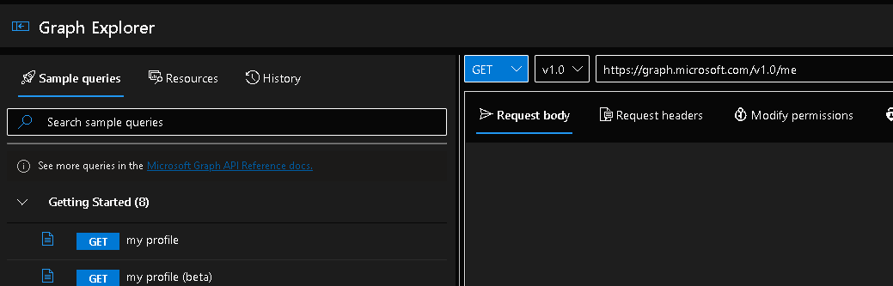

Tips & Tricks
Graph Explorer
F12 Network Tools
Graph X-Ray
Out-gridview

Slide 21

Q&A

